Slide 1
Rovnako, ale predsa inak …
Ľubomír Bandžuch

Slide 2
Prečo cloud?
Minimalizácia vstupných investícií – platba za spotrebu
Flexibilné riadenie výkonu a zdrojov podľa potreby
Presunutie IT infraštruktúry a aplikácií mimo lokálnu sieť
Zaistenie proti lokálnym výpadkom, katastrofám – georedundancia
Prístup odkiaľkoľvek - mobilná aplikácia, Internet vecí …
Stále aktuálna verzia systémov a aplikácií

Slide 3
Spoznávate situácie?
Nejde Vám otvoriť dokument? Akú verziu Office máte?
Online stretnutie? To je príliš komplikované …
Máme asi 10 verzií dokumentu v prílohe e-mailu, dúfam že mám tu poslednú …
Pol dňa mimo kancelárie, na stretnutiach. Je to nutné?
Pozriem sa na Váš list až keď budem pri počítači, u seba mám iba telefón.
Ten e-mail som asi nevidel, potreboval si niečo? Mal som plnú schránku a asi som ho vymazal.
To nestihneme, musíme počkať, až budeme všetci na úrade, aby sme sa nad tým poradili …
Notes:
The way that we have worked has changed so quickly in the last 5 years, and our tools haven’t. The result is frustration and tension. We are moving so quickly it can be hard to keep track of everything: which device we were using last, what document we were last reviewing, how to format a table in Excel, who we have given permissions to and if we incorporated changes…the list goes on.

Slide 4
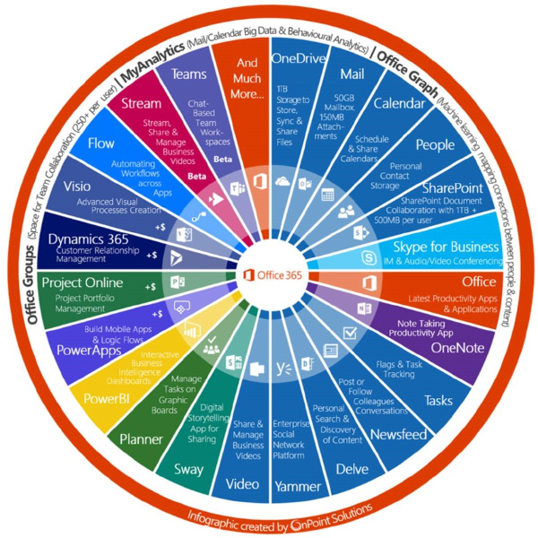
Online i offline verzia
99,99% dostupnosť (SLA)
Zmluvne garantovaná bezpečnosť, ISO 27001
Napojí sa na stávajúce IT
Microsoft je zodpovedný za aktualizácie a prevádzku služby
Nové verzie a funkcie v cene
Nejlepší pomer cena/výkon
Zalicencovánie 5 zariadení
Čo je vlastne Office 365 ?
Úložisko dokumentov s možnosťou
zdieľania
Firemný
e-mail a chat
Online
schozky
(HD video)
Súkromná sociálna sieť
Finančne zaistená dostupnosť služby
Office pre Windows/Mac
Office Mobile
Office Online
Technická podpora
Notes:
Slide purpose: Introduce that Office 365 is your complete office in the cloud
How to present this slide: Keep in mind that most people, when they hear “Office 365”, only hear “Office” and think “Word, PowerPoint, Excel”. And when they hear “cloud”, they think “browser-based applications” only, thinking this is only a browser-based version of Office, similar to Google Apps. So it’s important to take your time and labor on these 2 points specifically. Transition from previous slide by saying, “We understand what technology you need to help you manage the business challenges you are facing. We are excited that there is a new offering in the market that has been designed specifically for you….”
Talk track
Office 365 is your complete office in the cloud.
When we say “complete office”, first of all, we mean the Office apps that you know and love – Word, PowerPoint, Excel, Outlook, etc. With Office 365, you get these same apps as you have always used them, as desktop apps. The difference is, you are now subscribing to Office. Which means, you will always get the latest version of these Office apps on your desktop, whether you are online or offline. In addition to desktop apps, you also get Office Mobile on your smart phones for viewing and editing on the go. As part of our continuous commitment in improving the services, we announced in July 2013 that we are supporting Office Mobile for both iPhones and Android phones. For any other devices, or when you don’t have your devices with you, you still have Office Online which allows you to open and edit documents and emails in any browser.
But that’s not all, there’s so much more you get with Office 365. You get Office, [click] plus all these services and benefits. You get cloud-based productivity services hosted by Microsoft, including business-class email, file sharing, HD video conferencing, all working together and connected to Office so you have anywhere access to everything you need to run your business. And these are all enterprise-level services optimized for smaller businesses, so it’s easy to set up and manage, with a financially-backed SLA and 24/7 technical phone support for critical issues.
Office 365 is your complete office in the cloud and the best way to acquire the new Office.

Slide 5
Ponuka 10 10 10 pre prednostov a slovenské mestá
Prvých 10 miest, ktoré prejavia záujem o cloudové riešenie Office 365
V rozsahu minimálne 10 klientských staníc
Záujem do 30. Apríla 2017 a nákup do 30. Júna 2017
Získate:
10% z doporučenej koncovej ceny na štúdiu prevoditeľnosti, migráciu prípade školenie zamestnancov prostredníctvom Microsoft certified partnera
5% zľavu na nákup cloudových služieb

Slide 6
Kontakt:
Ľubomír Bandžuch
Tel: +420 725 850 931
Mail: lubandzu@microsoft.com

